Slide 1
Software Testing
Unit 1
INTRODUCTION

Slide 2
Content
A perspective on Testing
  Basic Definition
  Test Cases
  Insights from a Venn Diagram
  Identifying Test Cases
    Functional Testing
    Structural Testing
  Error & Fault Taxonomies
  Level of Testing

Slide 3
Why Do we Test.?
To make a judgment about quality or acceptability.
Discover Problems
Check whether all specifications are met or not?

Slide 4
Basic Definitions
Error(mistake): mistake while coding-bug
Fault(defect): Result of an error
  Fault of omission
  Fault of commission
Failure: A failure occurs when a Fault executes.
Incident: Alerts user occurrence of a Failure
Test: concerned with errors, faults, failures, incident
Test Case: have identity & is associated with a program behavior. Has i/p & o/p

Slide 5
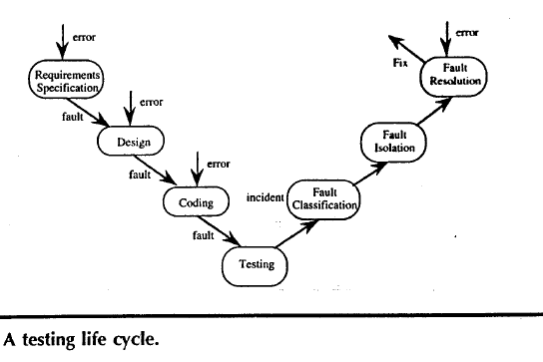

Slide 6
Process of testing
Test planning
Test case development
Running test cases
Evaluating test results

Slide 7
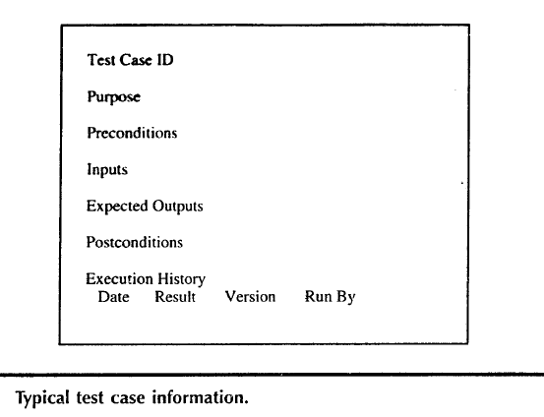
Test Cases

Slide 8
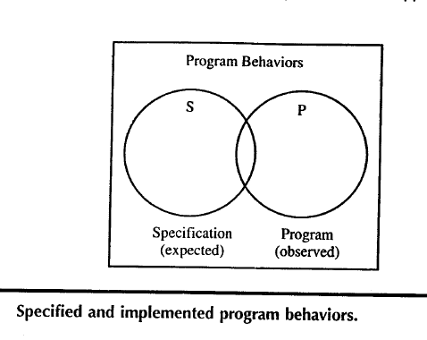
Insights from a Venn Diagram

Slide 9
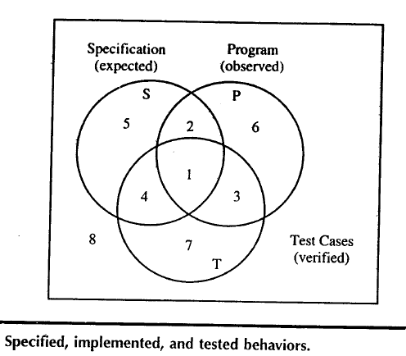
Cont.,

Slide 10
Venn diagram Continues…
Draw the Venn diagram for the following
2,4,5 are Specified behaviors
3,6,8 are Programmed behaviors
1,7,9 are Tested behaviors
10,11, are Specified and Programmed behaviors
14,17 are Programmed and Tested behaviors
12, 13 are Specified and Tested behaviors
15,16,19 are Specified ,Programmed and tested behaviors.

Slide 11
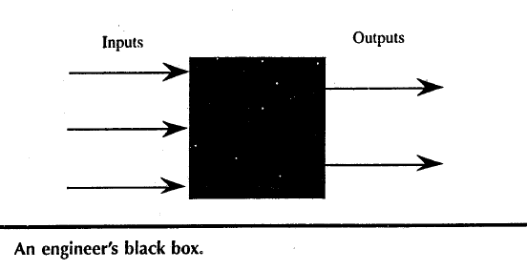
Identifying Test Cases
Functional Testing( Black Box Testing): implementation of Black box is not known.
Function of black box is understood by i/p & o/p.

Slide 12
Functional Testing
Advantages
  Independent of how the software is implemented.
  If implementation change test cases are still useful
  Test case development can occur in parallel with the implementation.
Disadvantage:
  Redundancies may exist among test cases
  Possibility of gaps of untested software.

Slide 13
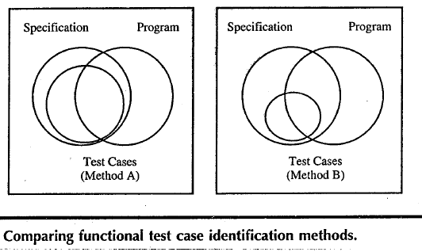
Conti.,

Slide 14
Structural Testing
Also called white box testing( even clear box Testing)
Implementation (of the Black box) is known & used to identify test cases.

Slide 15
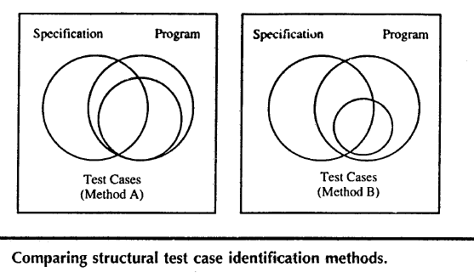

Slide 16
The functional VS Structural Debate
Goals of both approach is to identify test cases.
Functional testing uses only the specification to identify test cases.
Structural testing uses the programs source code(implementation) as the basis of test case identification.
Functional testing is behavior testing of software
Structural testing is logic testing of software
Functional testing is carried out by a group of people belongs to testing team
Structural testing is carried out by S/w developer.

Slide 17
The functional VS Structural Debate
Mendatory to have have knowledge of programming.
Knowledge of programming is not mendatory
Applicable to higher level of testing of software
Generally applicable to lower levels of software testing
Testing can be done by trial and error method
One should have domain and programming knowledge
Functional testing is closed box testing
Structural testing is called as clear box testing

Slide 18
Contd….
Types of Black box (Functional) testing
i. Functional testing
ii. Nonfunctional testing
iii. Regression testing
Types of White box (Structural ) testing
i. Loop testing
Conditional testing
Path testing

Slide 19
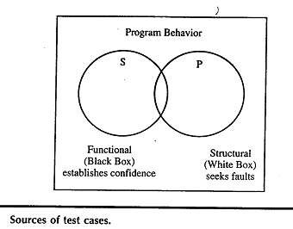
Cont.,
When functional test cases are executed in combination with structural test coverage metrics twin problems redundancies & gaps faced by functional testing can be recognized & resolved.

Slide 20
Testing as a craft
When we know what kind of error we are prone to make
If we know what kind of faults are likely to reside in software to be tested.
We can use this to employ more appropriate test case identification methods.
At this point testing really becomes a craft.

Slide 21
Error & Fault Taxonomies
Definition of error & fault hinge on the distinction between process & product
Process-refer to how we do something.
Product-end result of a process.
SQA- tries to improve the product by improving the process.
Testing is clearly more product oriented.
Faults can be classified in several ways

Slide 22
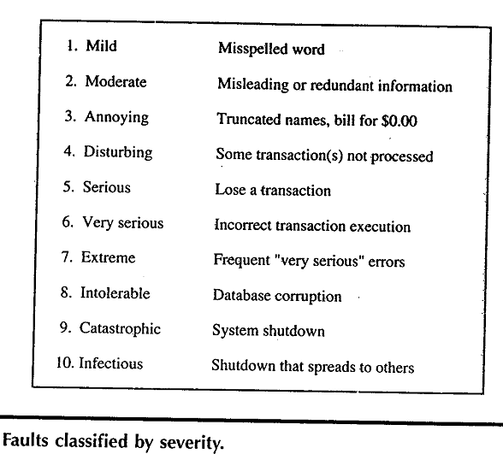

Slide 23
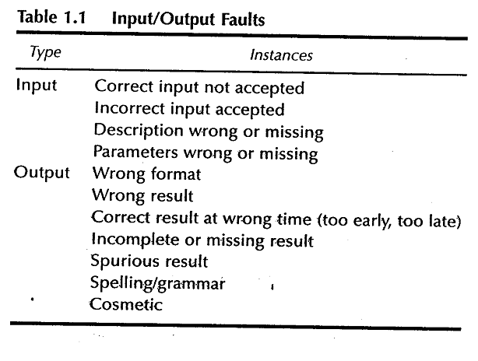

Slide 24
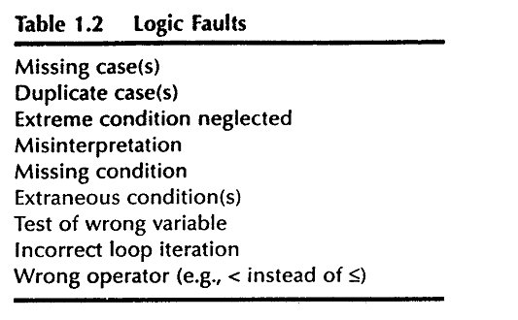

Slide 25
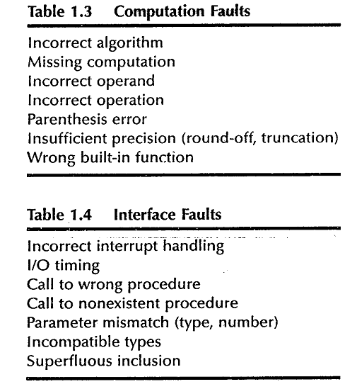

Slide 26
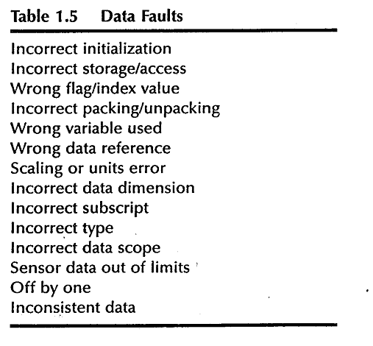

Slide 27
Levels of Testing
Levels of testing echo the levels of abstraction found in the waterfall model of the SDLC.
In functional testing 3 levels of definition (specification, preliminary design, detailed design) correspond directly to 3 levels of testing –system, integration & unit testing.

Slide 28
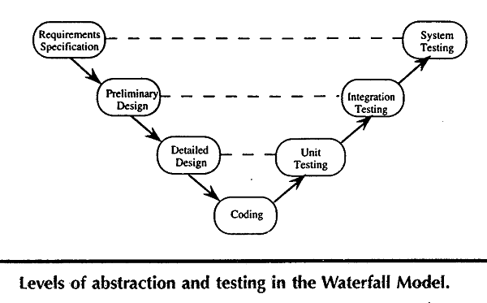

Slide 29
Examples
Three examples to illustrate various unit Testing methods.
These examples raise most of the issues that testing craftsperson's will encounter at the unit level.
For the purpose of structural testing, pseudocode implementation of 3 unit-level eg. are given.
  The triangle problem
  NextDate
  Commission problem

Slide 30
Generalized Psuedocode
Pseudocode provides a “language neutral” way to express program source code.
Pseudocode given here is based on visual basic.

Slide 31
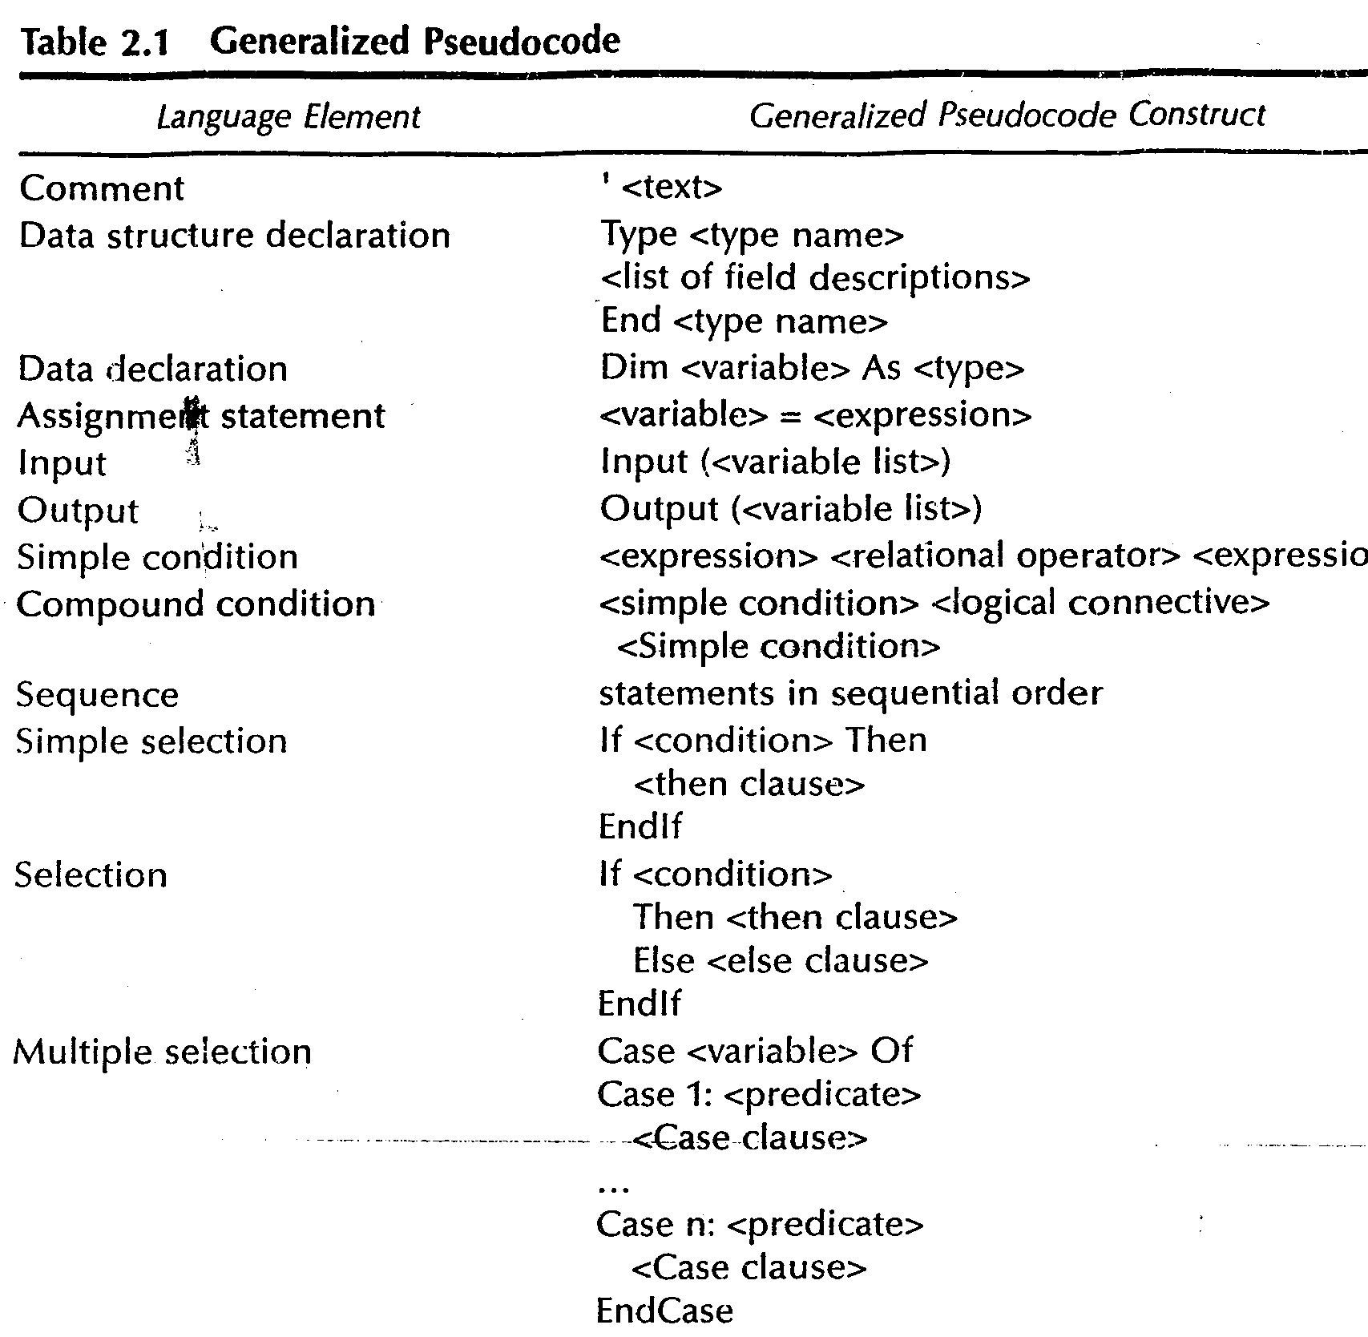

Slide 32
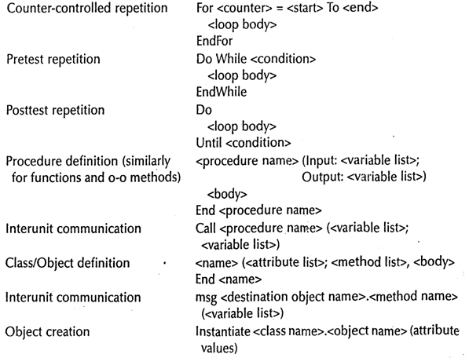

Slide 33
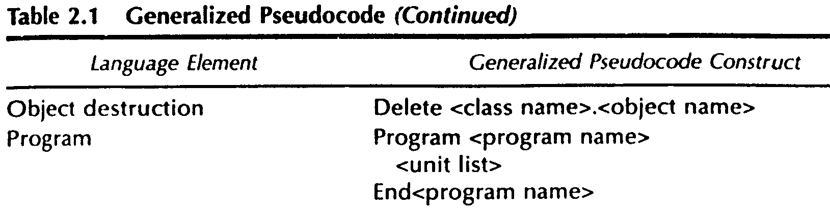

Slide 34
Triangle Problem
Problem statement
Simple version: The triangle program accepts 3 integers a, b, c as input to be sides of a triangle
o/p is type of triangle determined by 3 sides
Equilateral, Isosceles, Scalene, Not a triangle.

Slide 35
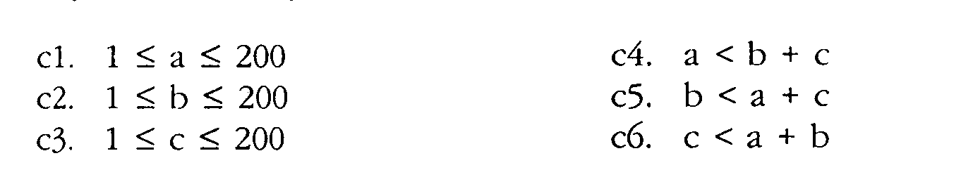
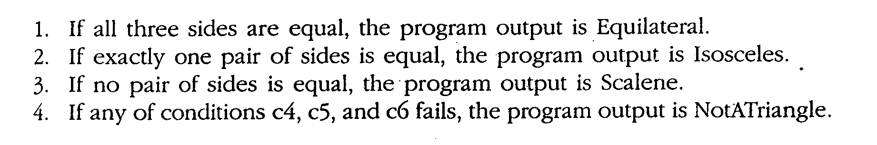
Improved version
Sides of triangle integer a, b, c must satisfy the following conditions
One of the 4 mutually exclusive output is given

Slide 36
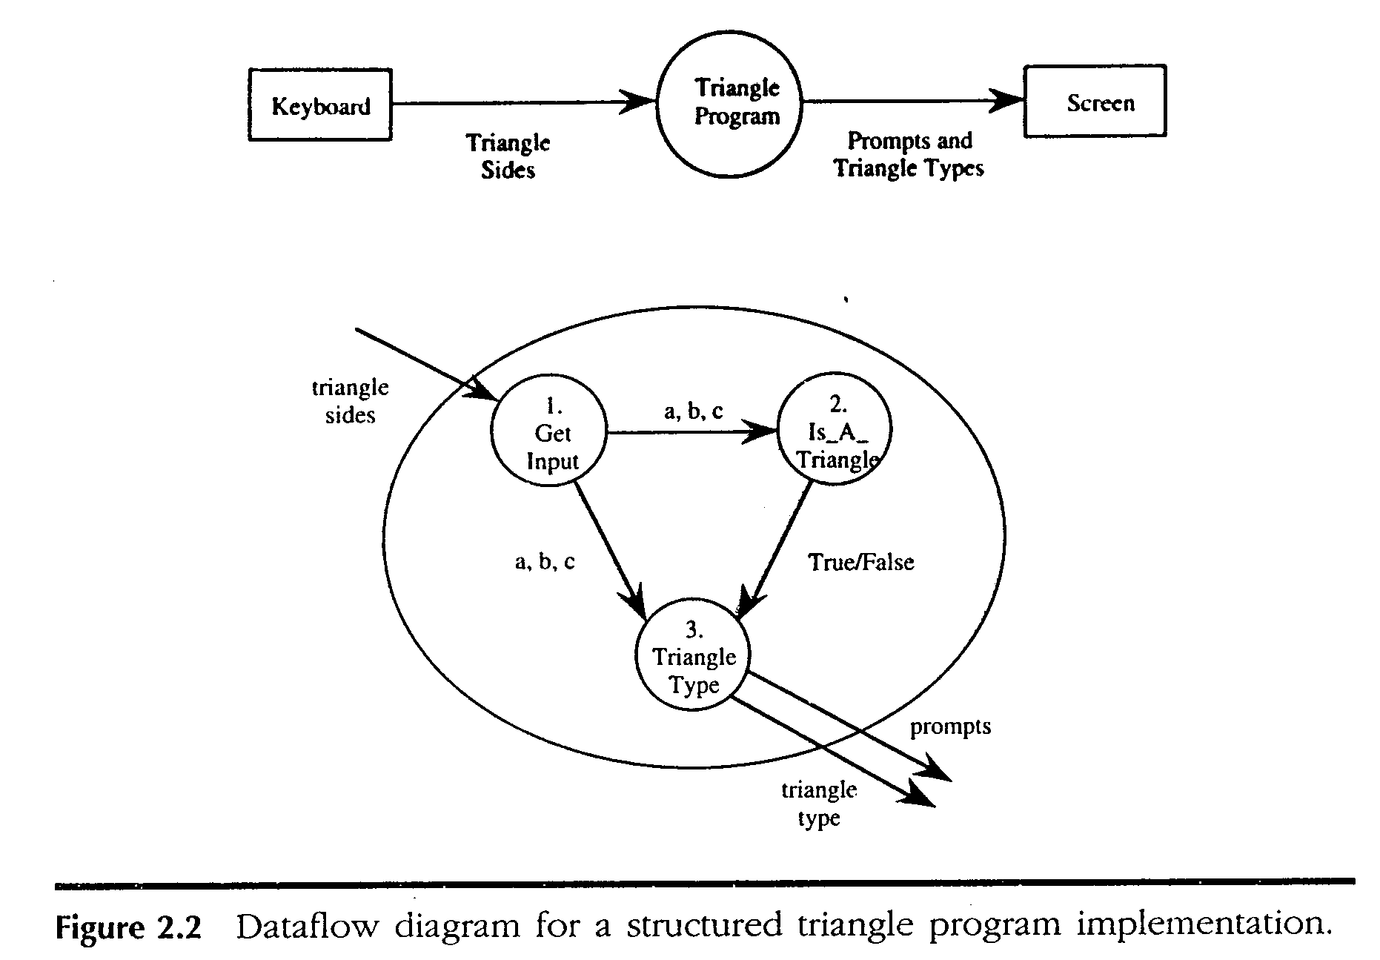

Slide 37
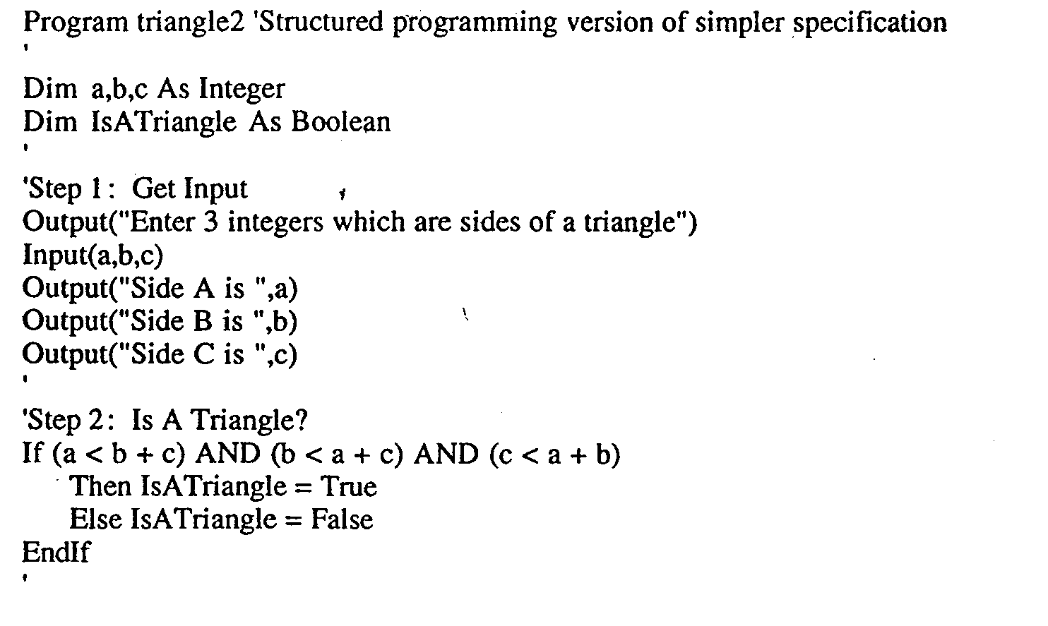

Slide 38
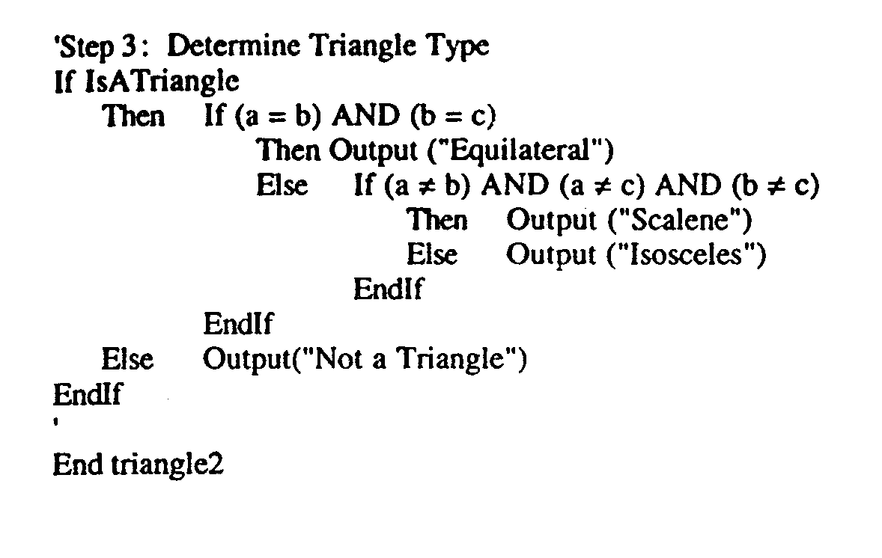

Slide 39
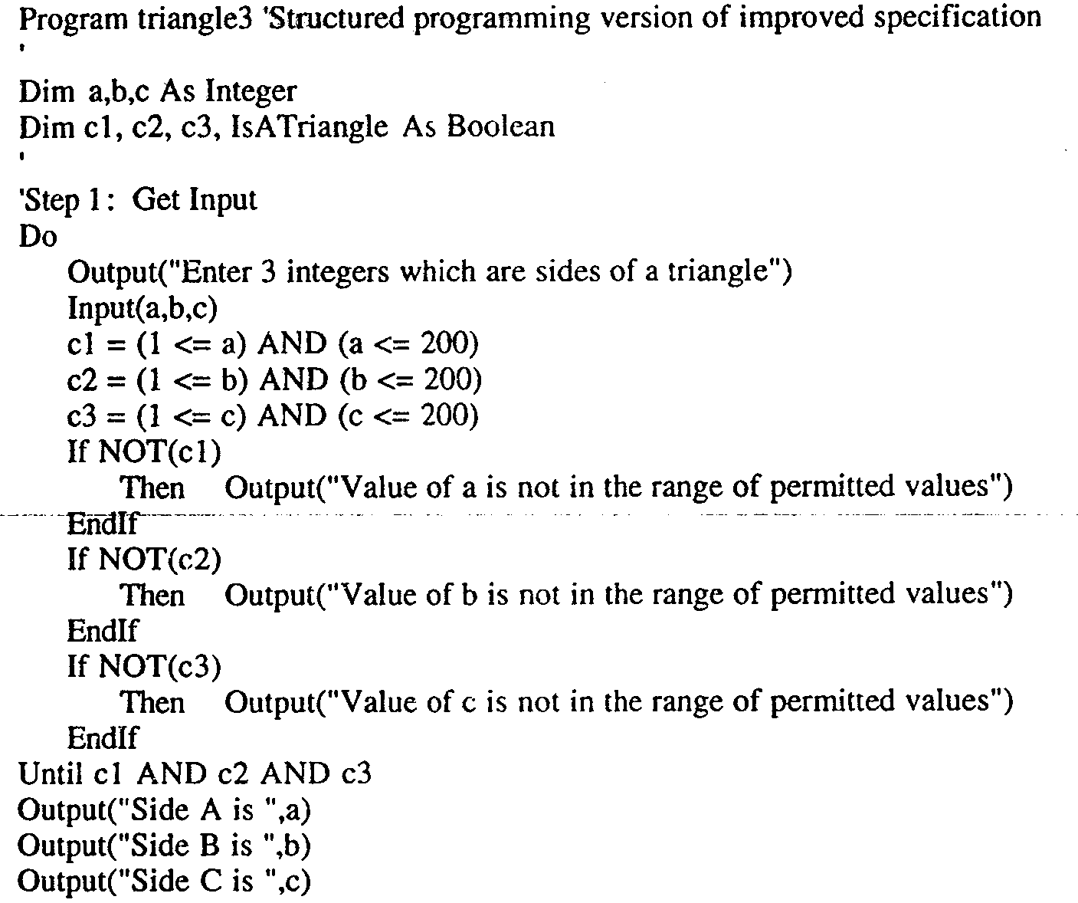

Slide 40
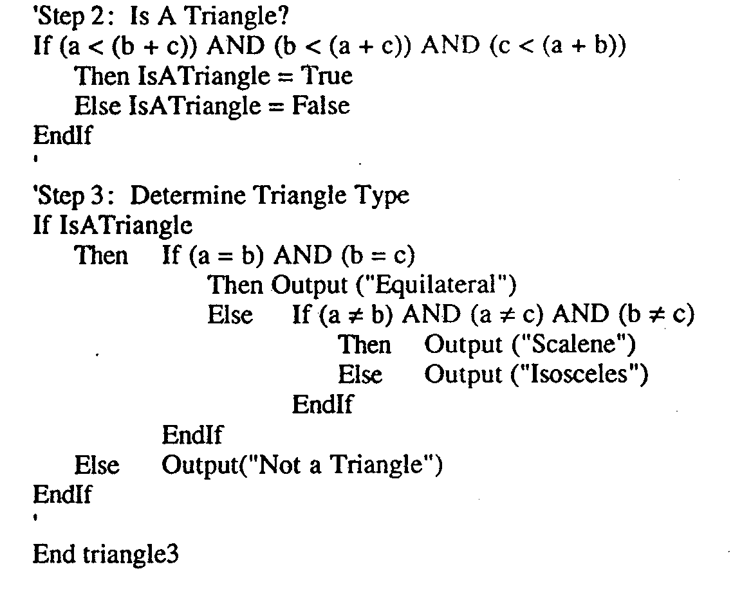

Slide 41
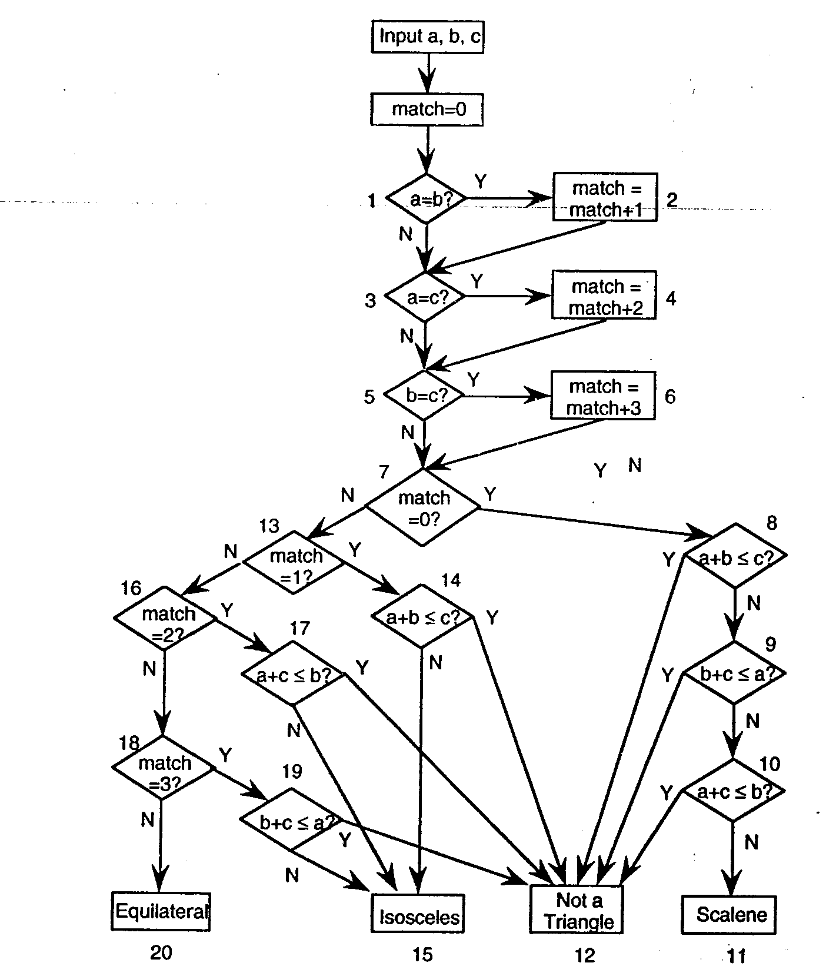
Traditional Implementation

Slide 42
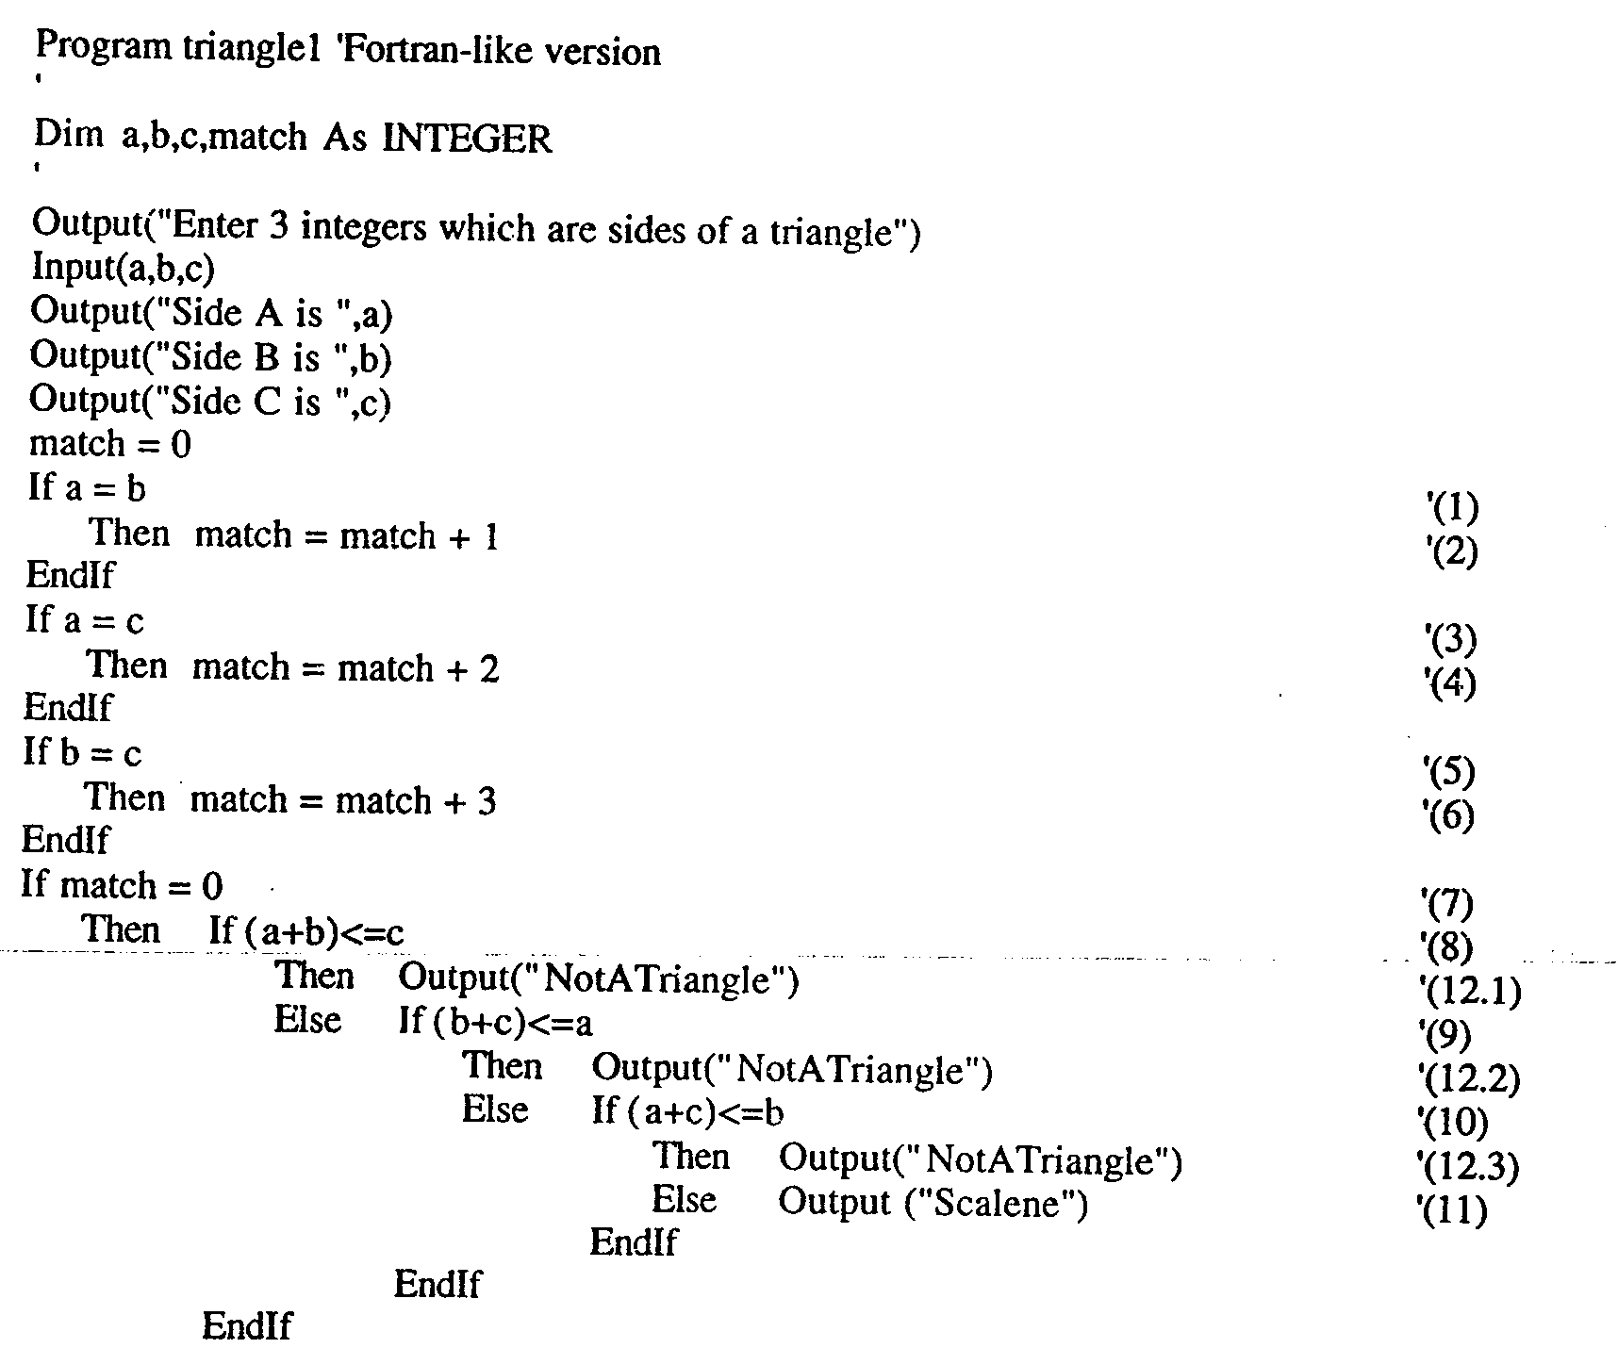

Slide 43
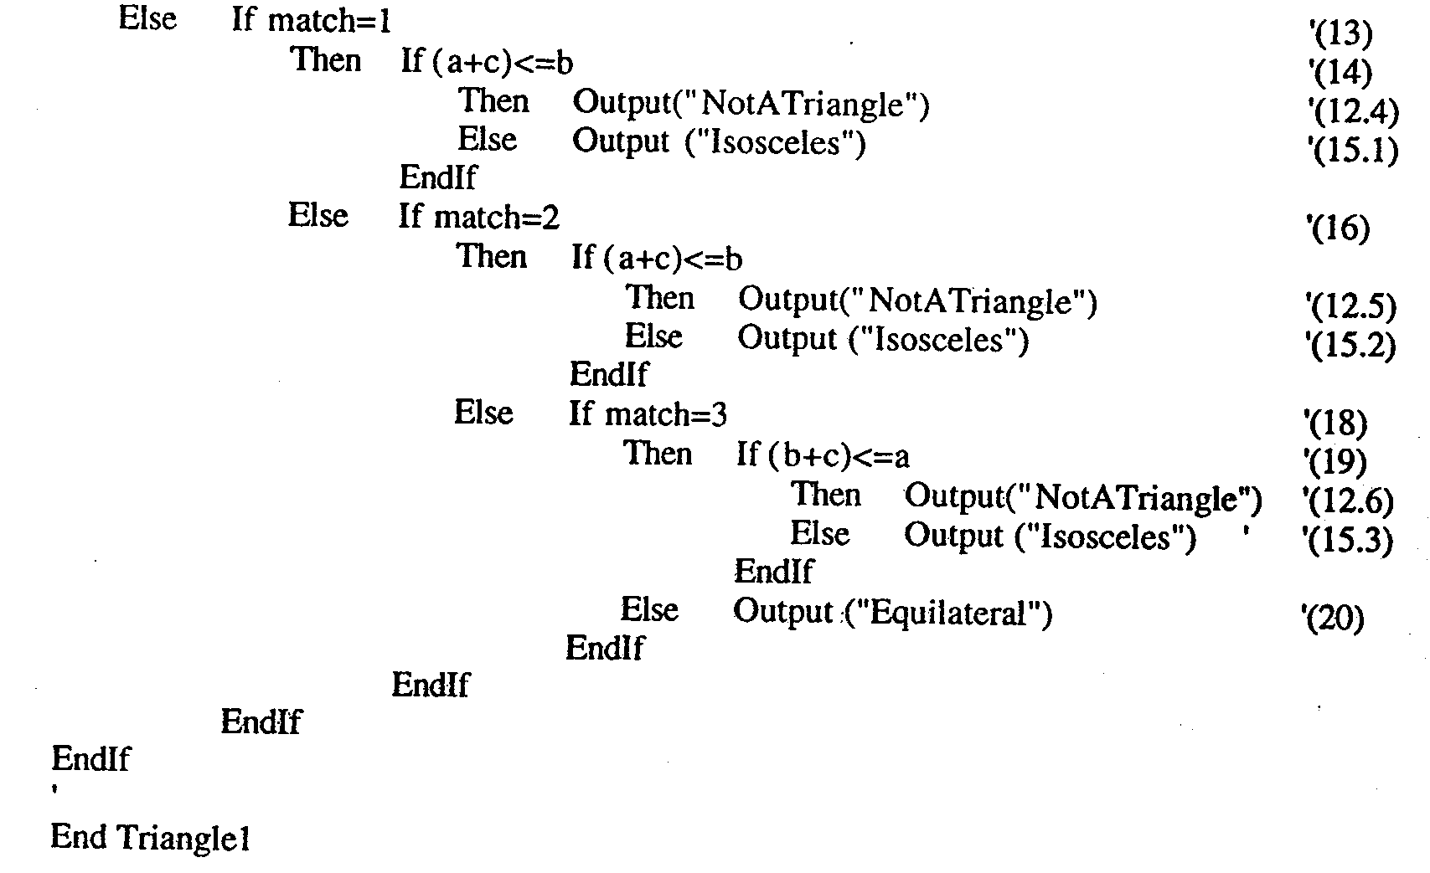

Slide 44
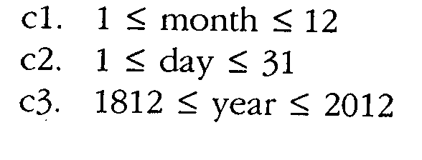
The NextDate Function
Illustrate complexity
Logical relationship among the i/p variables
Problem statement:
NextDate is a function of 3 variables Month, Day, Year.
It returns the date of the day after the i/p date.
condition

Slide 45
Problem statement
Responses for invalid values of i/p values for day, month, year.
Responses for invalid combination of i/p june 31 any year.
If any of the conditions C1, C2, or C3 fails
  Corresponding variables has out-of-range values.
  Eg. “Value of month not in range 1…12”
If invalid day-month- year combination exist NextDate collapses these into one message
“Invalid input date”

Slide 46
Discussion
Two source of complexity
  Complexity of input domain
  Rule that determine when a year is leap year.
A year is 365.2422 days long
Leap years are used for the “extra day” problem.
According to Gregorian calendar
  A year is a leap year if it is divisible by 4, unless it is a century year.
  Century years are leap years only if they are multiples of 400
  So 1992, 1996, 2000 are leap years… 1900 is not

Slide 47
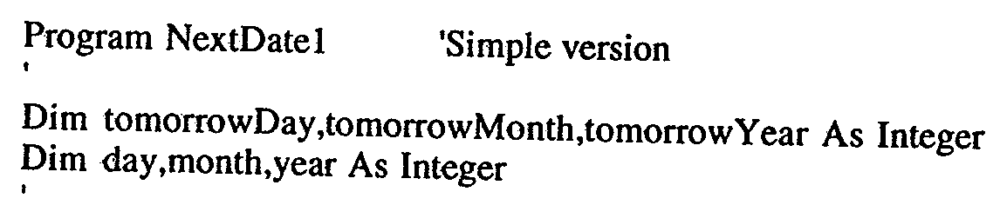
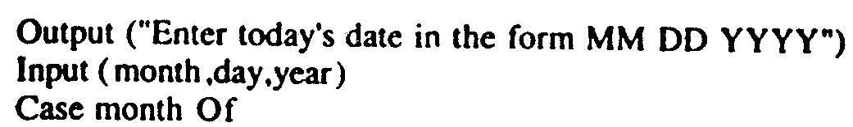
Implementation

Slide 48
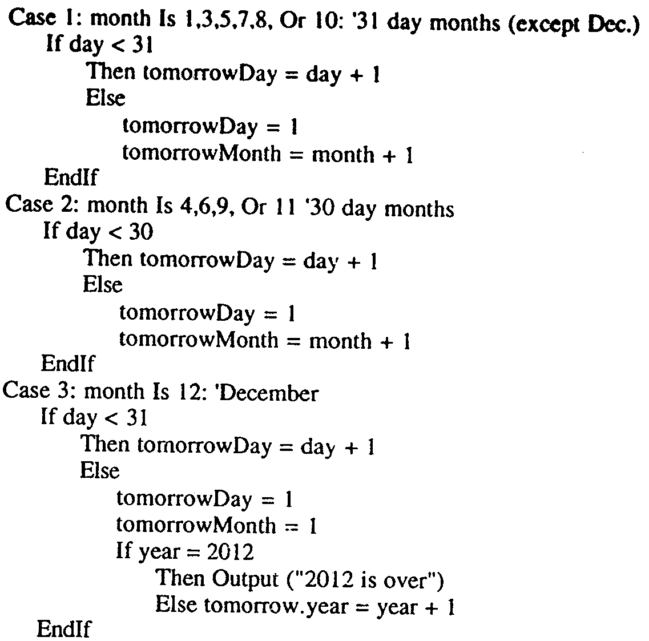

Slide 49
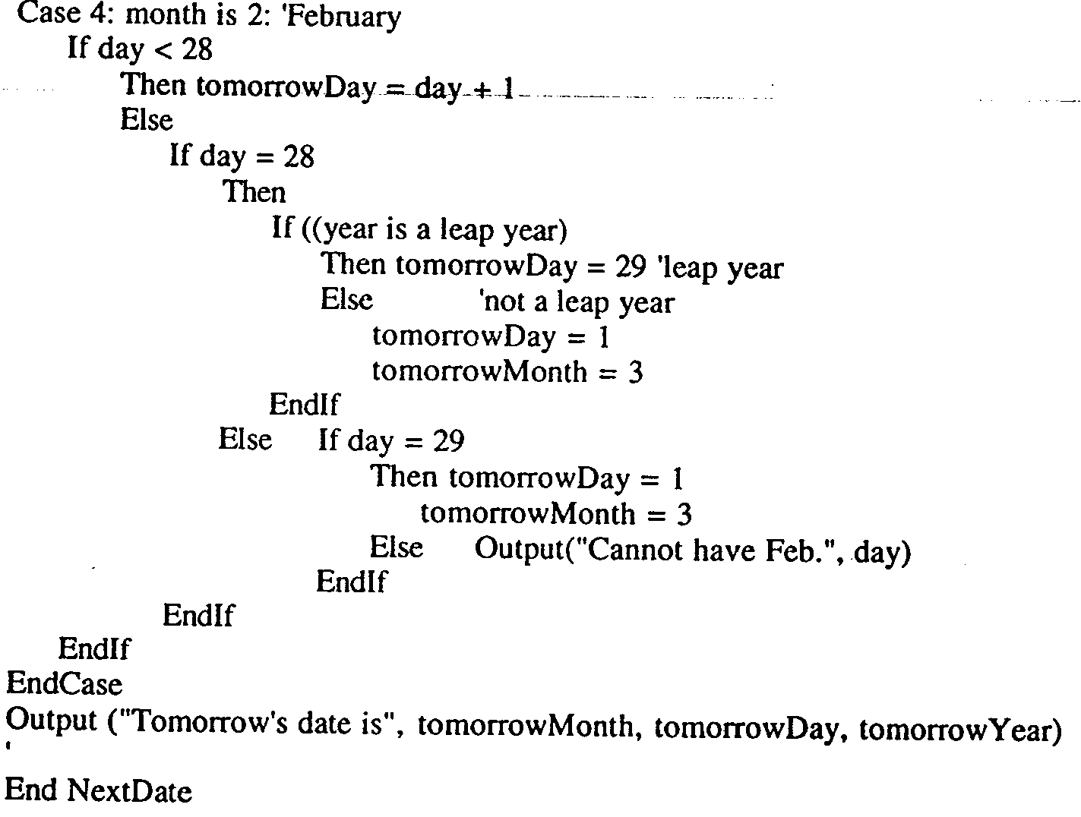

Slide 50
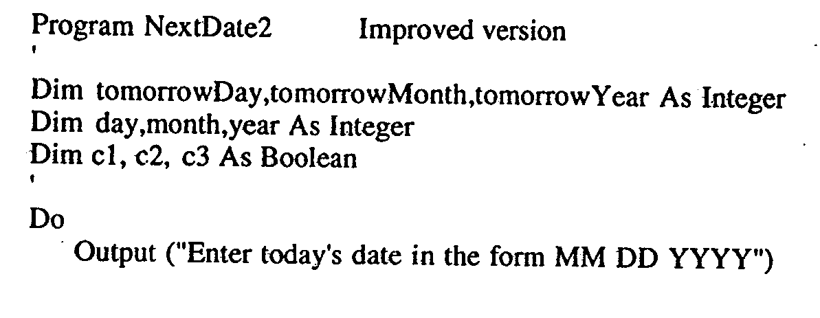
Improved Version

Slide 51
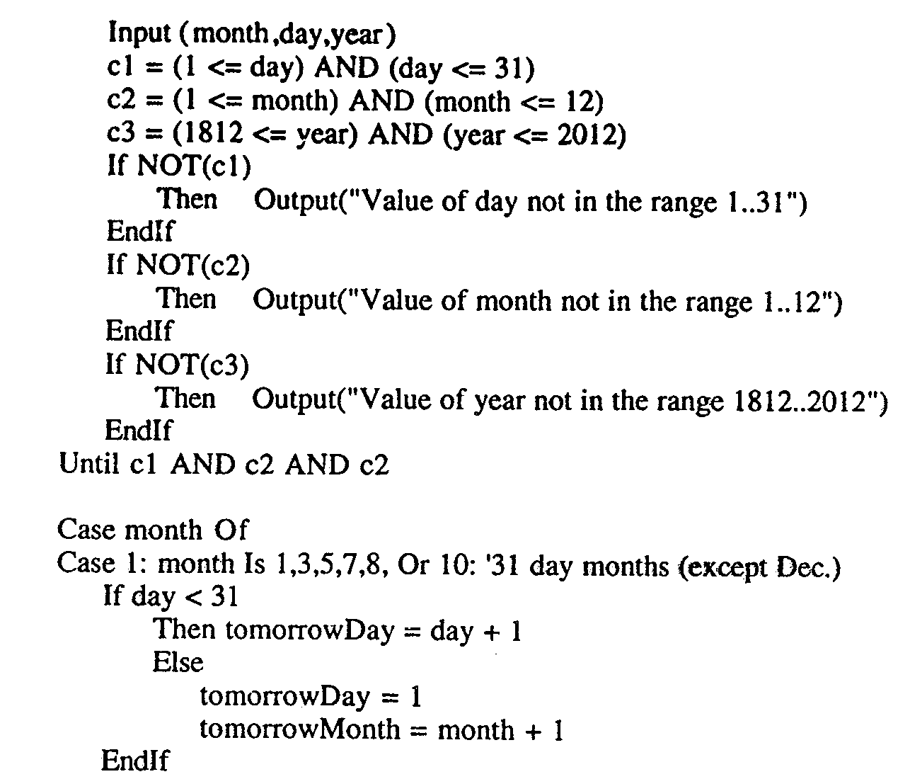

Slide 52
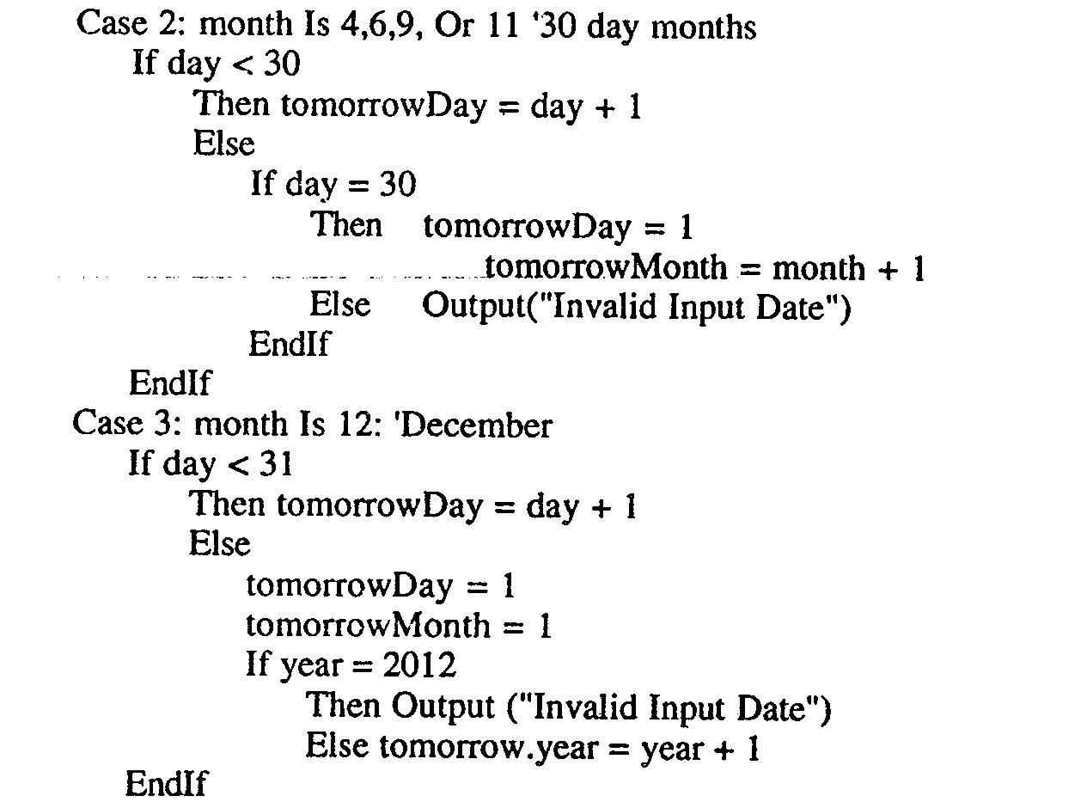

Slide 53
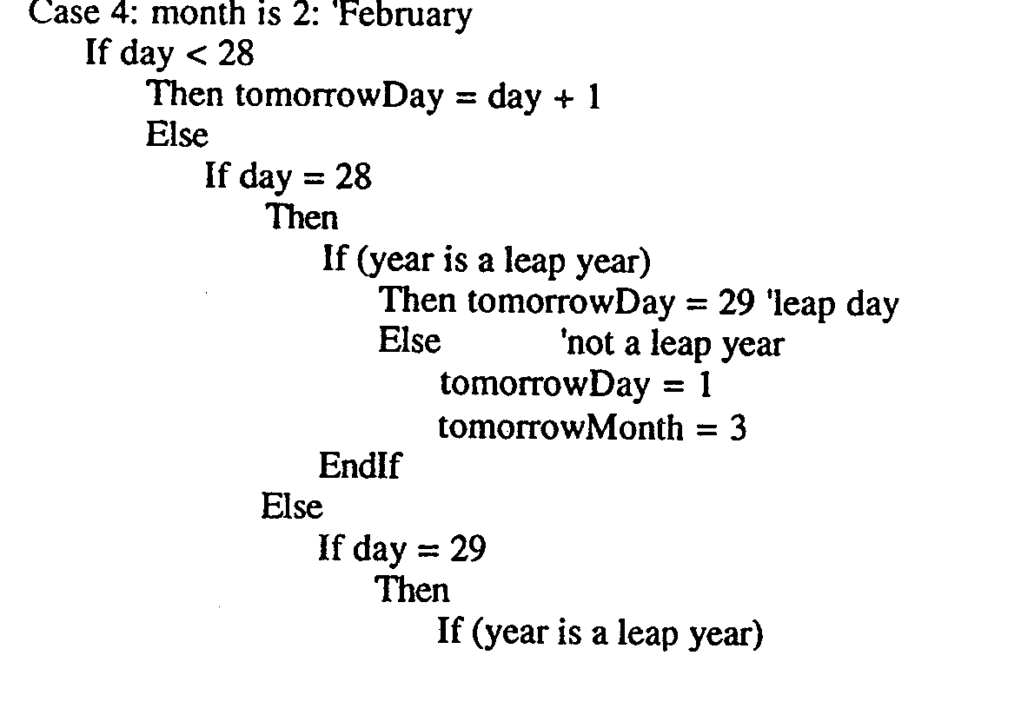

Slide 54
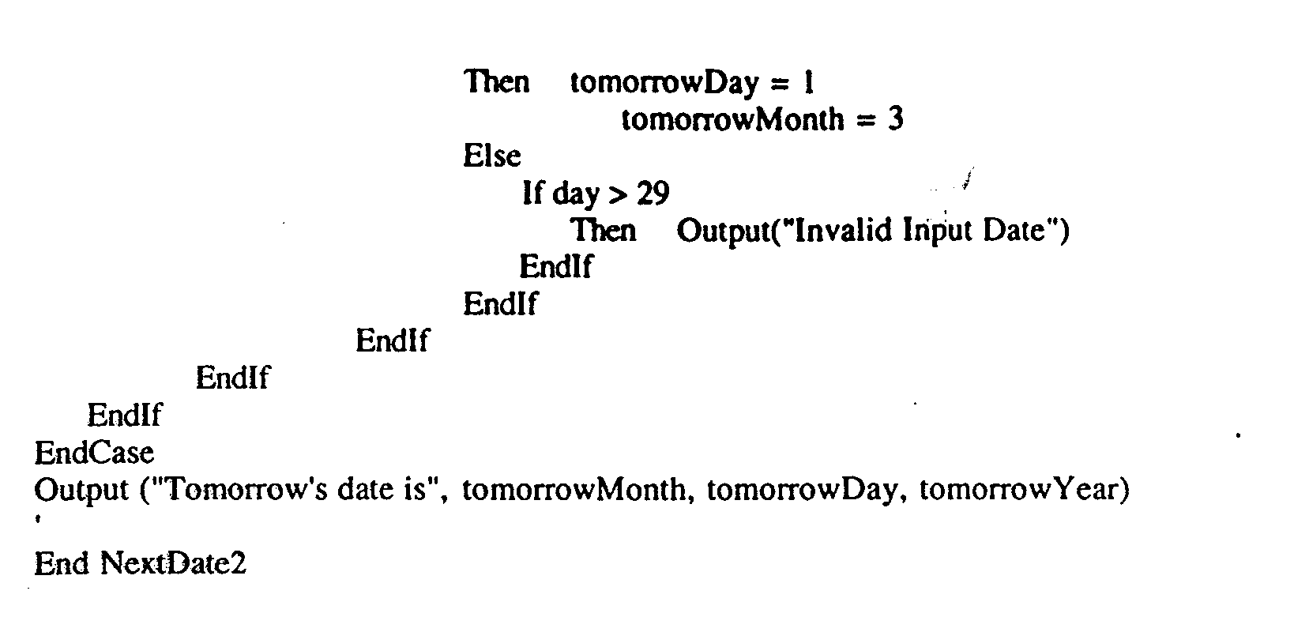

Slide 55
The commission Problem
It contains a mix of computation & decision making.
A rifle salesperson in the former Arizona territory sold rifle lock’s, stocks, & barrel’s made of a gunsmith in Missouri.
Locks cost $45, stocks cost $30, Barrel Cost $ 25.
Sales person has to sell at least 1 complete rifle per month
Production limitation such that 1 sales man can sell 70 locks, 80 stocks, 90 barrels per month.

Slide 56
After each town visit salesperson update sale of no of locks, stocks, barrels through a telegram to gunsmith
At the end of month salesperson sent a shot telegram showing -1 locks sold.
Gunman knew sales for month are over & compute the commission of sales person
  10% on sales up to $1000
  15% on the next $800
  20% on any sales in excess of $1800
  The commission program produces a monthly sales report that gave total no. of locks, barrels, stocks sold. Sales persons total dollar sale & commission.

Slide 57
Discussion
This problem separates into 3 distinct pieces
The input data portion( data validation) ignore here
Sales calculation
Commission calculation problem.

Slide 58
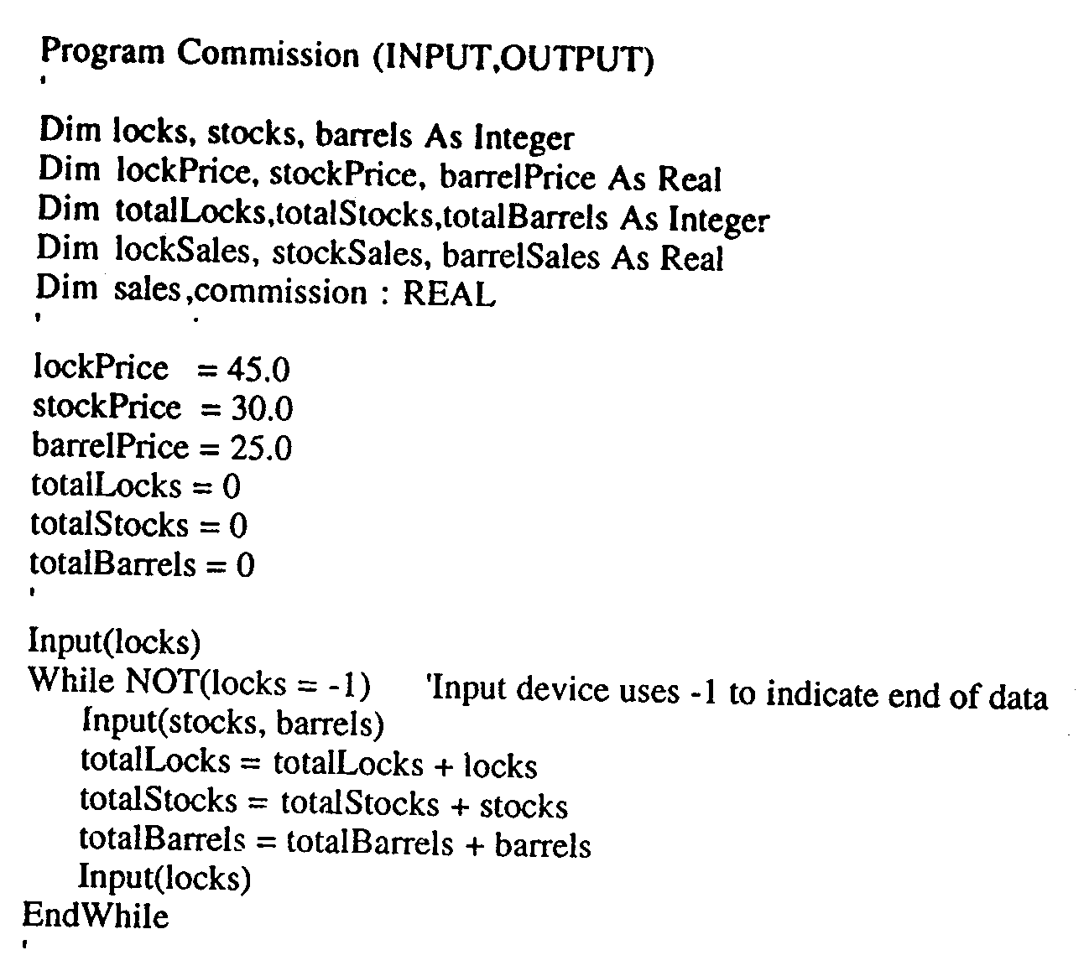
Implementation

Slide 59
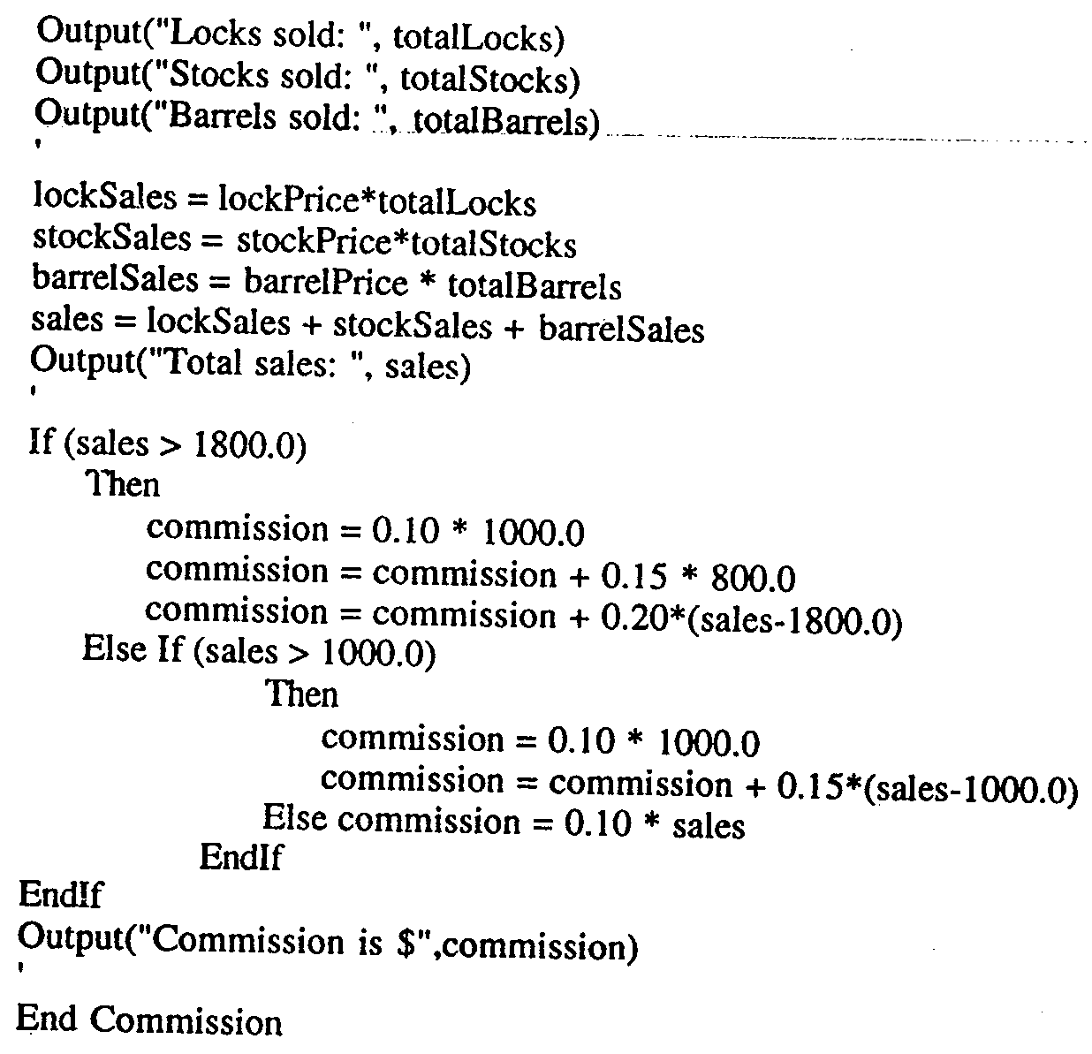

Slide 60
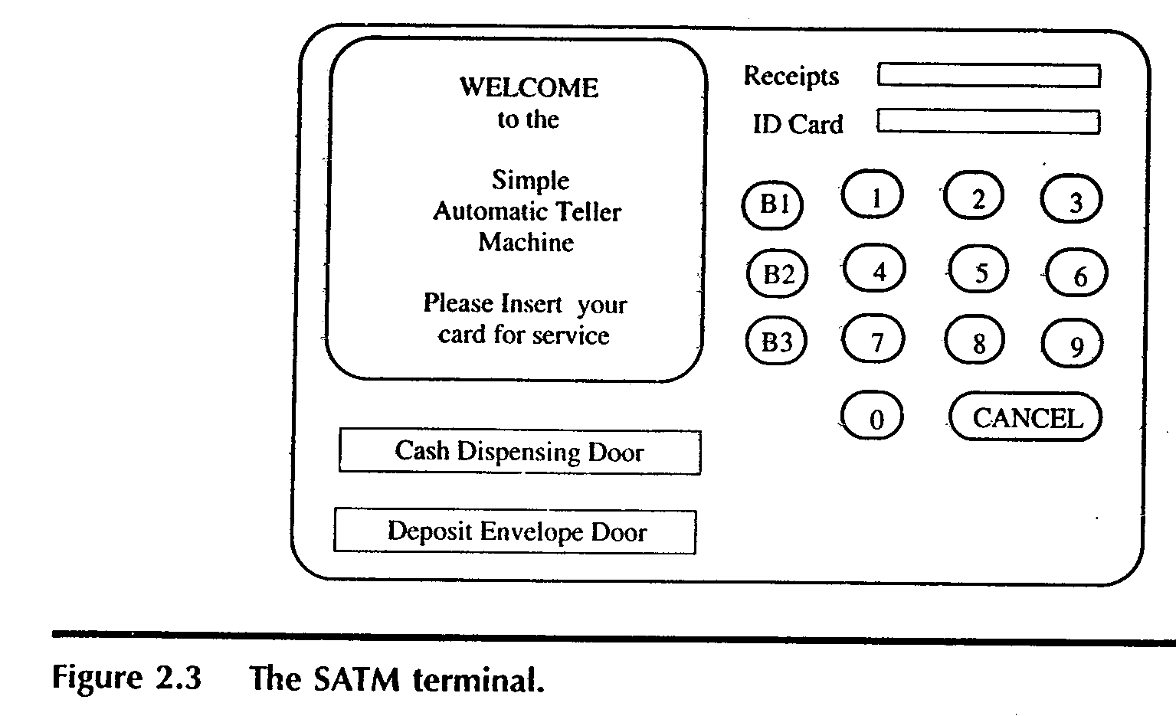
The SATM System
To better discuss the issues of integration & system testing

Slide 61
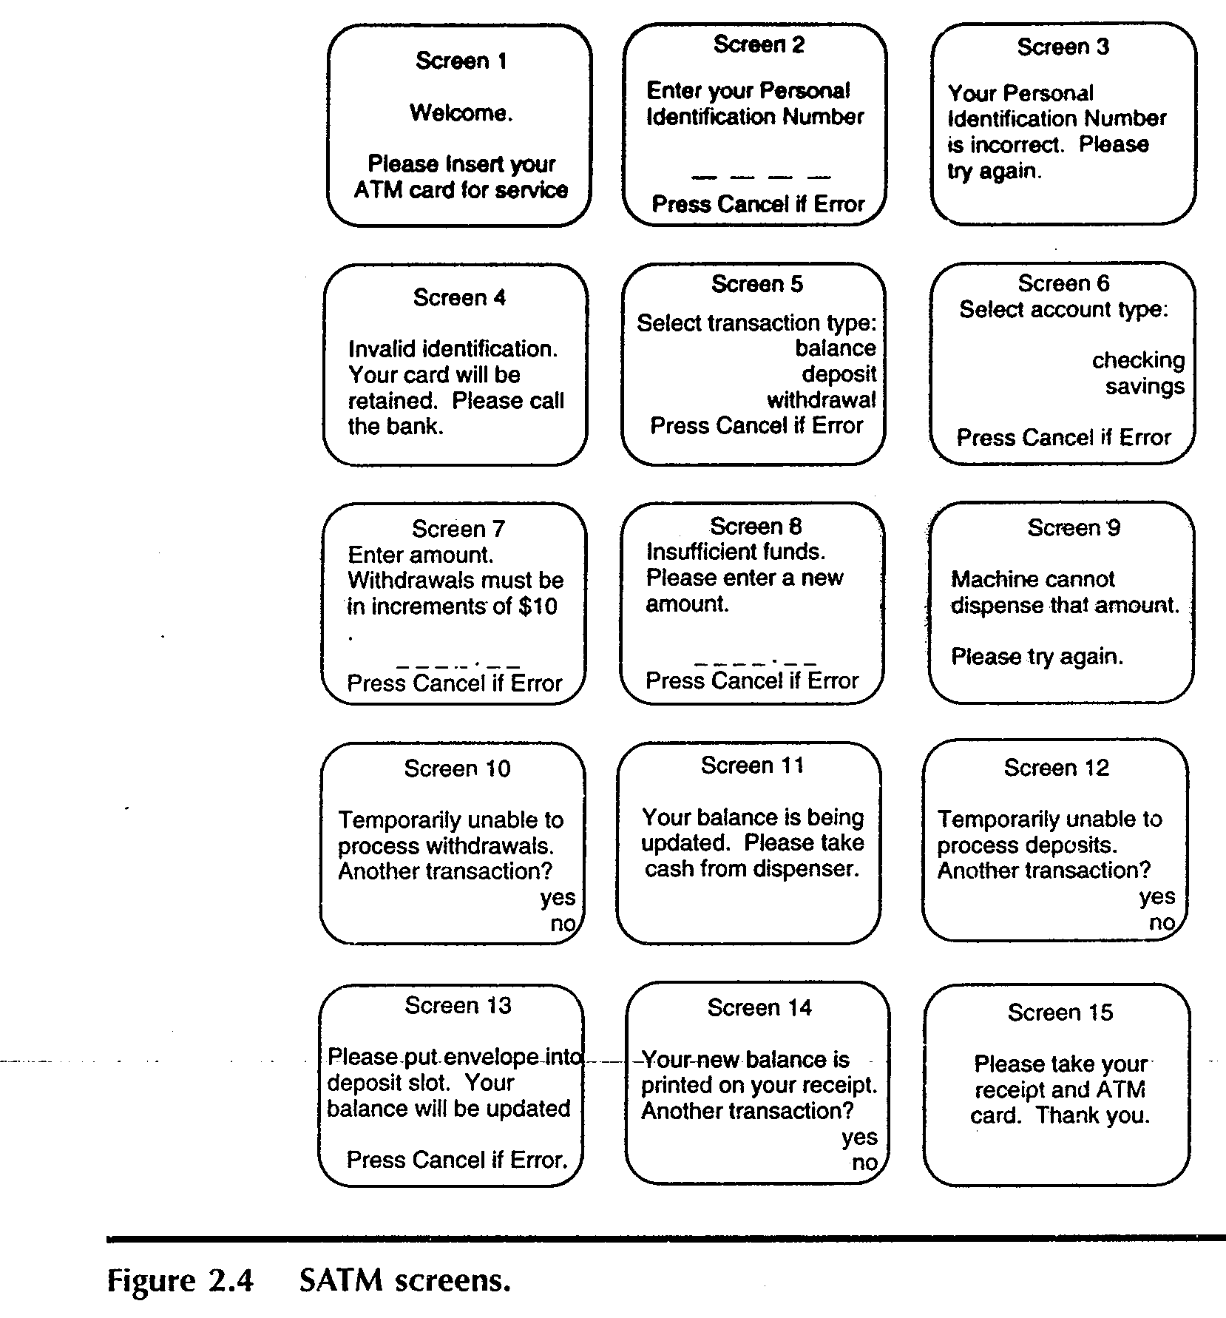

Slide 62
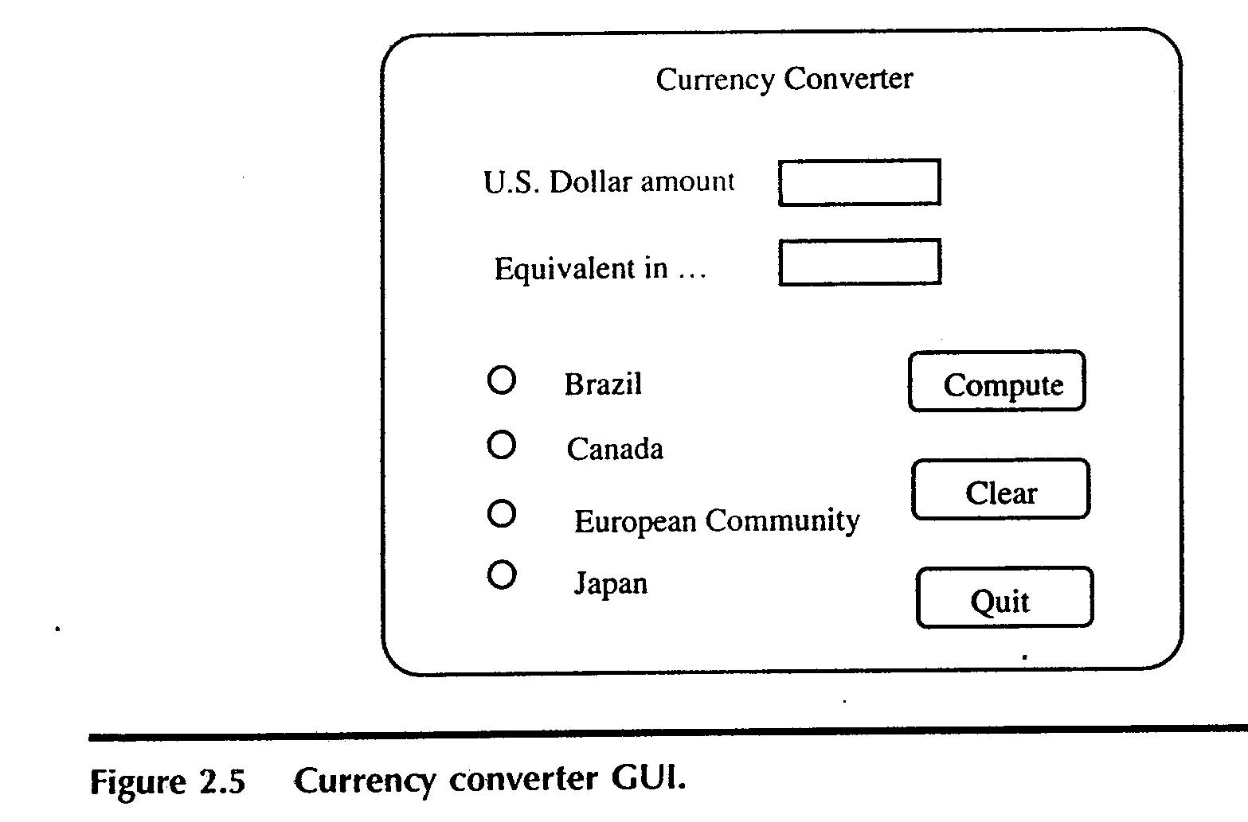
The currency converter
Another event driven program that emphasizes code associated with a GUI
A sample GUI built with visual basic is shown.

Slide 63
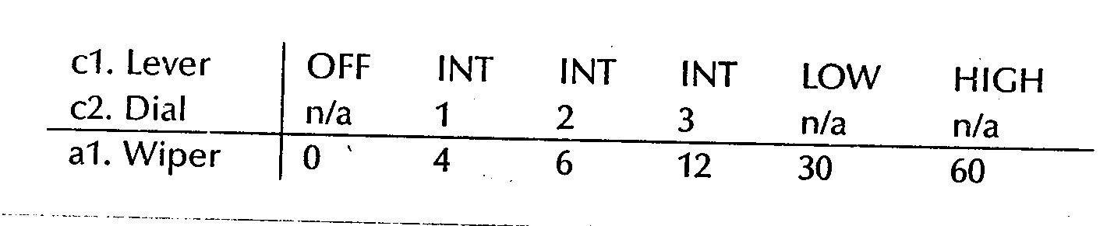
Saturn Windshield Wiper Controller

Slide 64
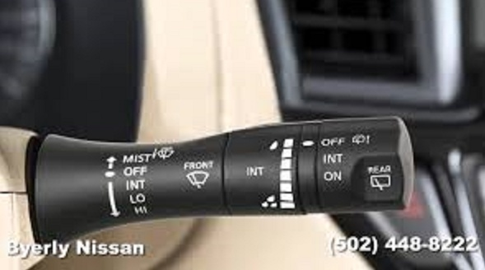

Slide 65
Thank you ???

Slide 66
References
Software Testing Craftsman’s Approach-Paul C Jorgensen.

